Slide 1

Agile Presentation
By Jesse Moore
CS 250 – Software Development Lifecycle
Professor Jacobs

Slide 2
Agile Roles
There are 3 main roles on a Scrum-Agile Team, each with unique responsibilities that help the team succeed:
Scrum Master – acting “Project Manager” and coach to the team.
Product Owner – maximizes the value of the product
Developer – “frontline” team, working directly with the product
Each of these roles are played by individuals but they come together as a team for the sake of creating the best possible product together. Each role depends on the others for success.

Slide 3

Scrum Master
The Scrum Master fills the role of a Project Manager, but they are so much more. A good Scrum Master will guide their team, using their knowledge of scrum methodology, agile principles and best practices.
They are more like coaches than they are managers, supporting their team however they can where they notice they are needed. This is an important part of the development process as they can identify hangups and the team’s strengths, using what they know to support their team while maintaining deadlines.

Slide 4

Product Owner
The Product Owner’s responsibilities revolve around value. In order to maximize profit, the Product Owner must become the middle-man between the team and outside interests such as potential users and stakeholders.
Communication is huge when working as a team, and this is especially true for the Product Owner. Meeting with potential users, setting up surveys to gather User Stories, and communicating any important information given by stakeholders to the team raises the chances of a successful team and a successful product.

Slide 5
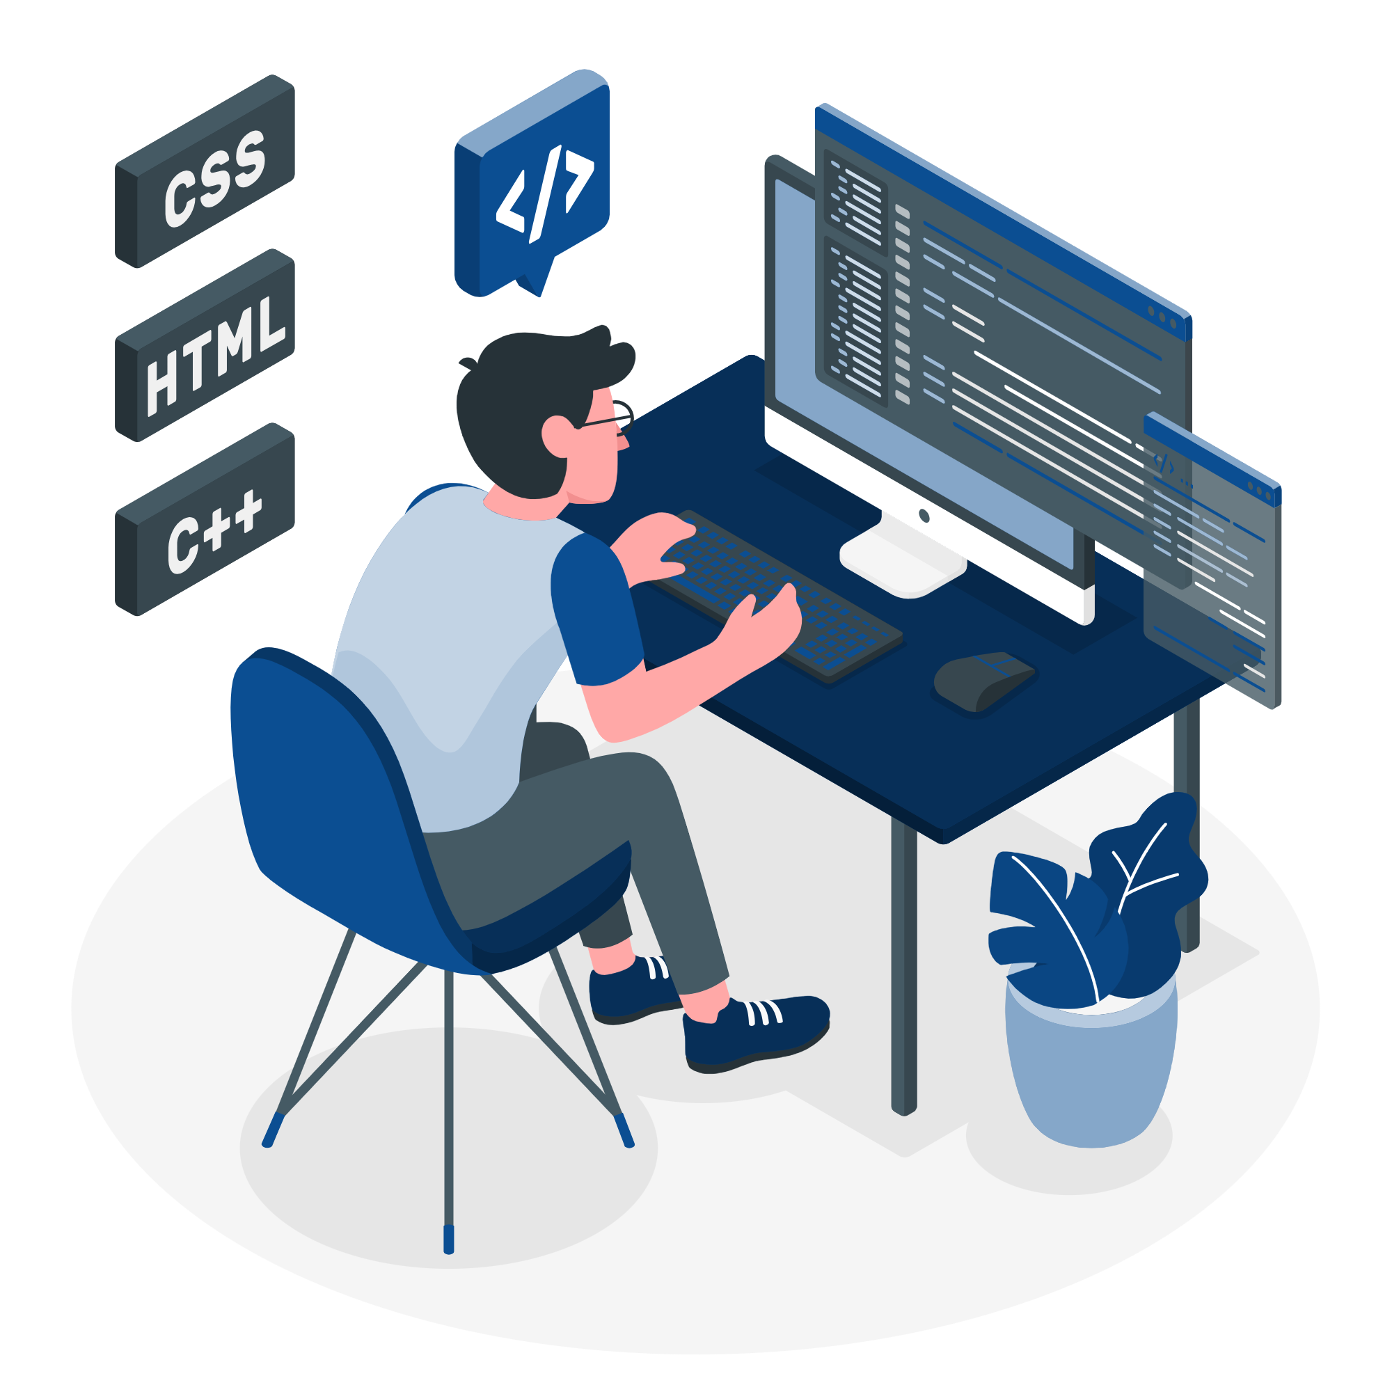
Developer
The Developers on a Scrum Team are the backbone of any project. They are truly in the trenches, working diligently to bring a product to life based on User Stories and set requirements and requests.
Communicating their needs or concerns with the Scrum Master, a good Developer will thrive in a team setting. Coding takes time and comes with challenges. The key to the success of the team is the Developers abilities to overcome roadblocks and request assistance from others where needed. Without them, no product would be made.

Slide 6
Phases of Agile
Agile projects are broken up into small sections of work known as “Sprints.” A Sprint consists of a small portion of time with a list of tasks to complete. These Sprints can be anywhere between a week and maybe even a month, usually lasting about 2 weeks. The purpose of this is to work on small chunks of work at a time, chipping away at the product. If changes in priority or goals manifest, the team will have the flexibility to deal with them as they come along, shifting workflow as needed to maintain their goals and deadlines.
The planning and action process looks a little like this…

Slide 7
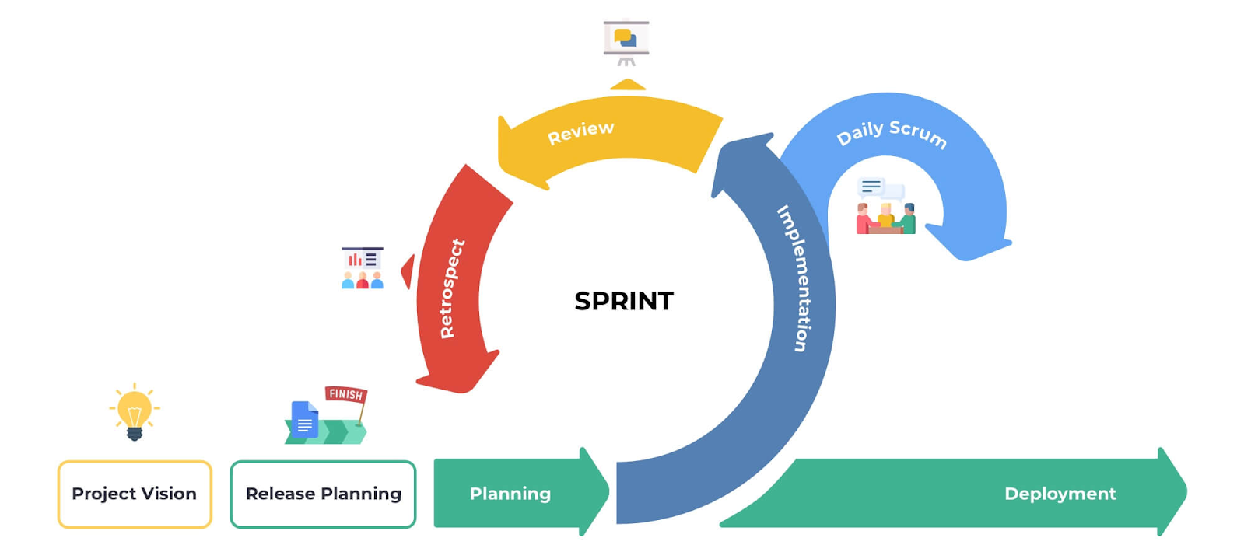
Phases of Agile
Once a project has been conceptualized and given to a team, they begin their planning. How they tackle the project will come down to what is required, how much time they will need versus how much time is given, and where each person is skill-wise.
Once the team has a rough estimate of the tasks they need to complete to provide the product, they will split these tasks up into Sprints. After each Sprint the team will meet to reflect on their progress. Daily meetings are held as well.

Slide 8
Waterfall Model
“The waterfall model is most commonly used in software engineering and product development, less often – in other projects and industries.”
Agile is not the ONLY way to be successful. Waterfall can be utilized effectively, but restrictions apply heavily. Your requirements must be known, clear, AND fixed before any work has been done. The project must also be short and simple. In Waterfall, all factors are considered from the beginning, and once the train gets going, there is no changing course, no room for changes. Any necessary adjustments must wait for the project to be completed as written.

Slide 9
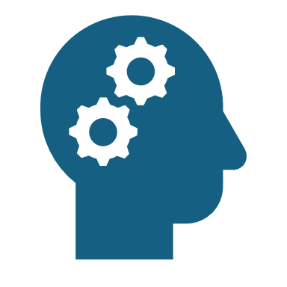
Agile Vs Waterfall
Agile’s values can be summed up in 3 words: “Prediction and Adaptation.”
- Working with Agile means working towards goals with the understanding that things happen, and when they happen you must account for them, pivoting work-flow to account for changes. This method is particularly effective for large and/or complex projects.
Waterfall’s values are more of a structured plan with little room for change once details have been decided.
- Working with Waterfall can work if the task is clear cut and you do not anticipate changes for the duration of the project. The task must also be fairly simple.

Slide 10
Thank You!

Slide 11
Sources
Donato, H., & Donato, H. (2023, November 13). What are the phases of scrum? Workamajig. https://www.workamajig.com/blog/scrum-methodology-guide/scrum-phases
Atlassian. (n.d.). Get Started with Jira - Comprehensive Beginner’s Guide. https://www.atlassian.com/software/jira/guides/getting-started/introduction#what-is-jira-software
Team, A. (2024, July 22). Waterfall model: What is it, when and how to use it? actiTIME - Time Tracking Software. https://www.actitime.com/project-management/what-is-waterfall-model
Cobb, C. G. (2023). The Project Manager’s Guide to Mastering Agile: Principles and Practices for an Adaptive Approach. John Wiley & Sons.

